Slide 1
PAYROLL MANAGEMENT SYSTEM IN JAVA USING SWING AND AWT

Slide 2
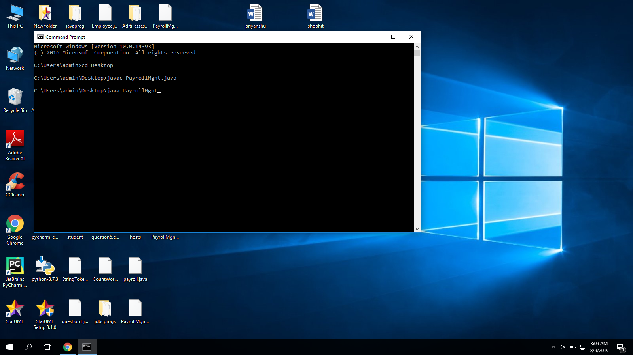
Creation of java file (PayrollMgnt.java) and compiling it

Slide 3
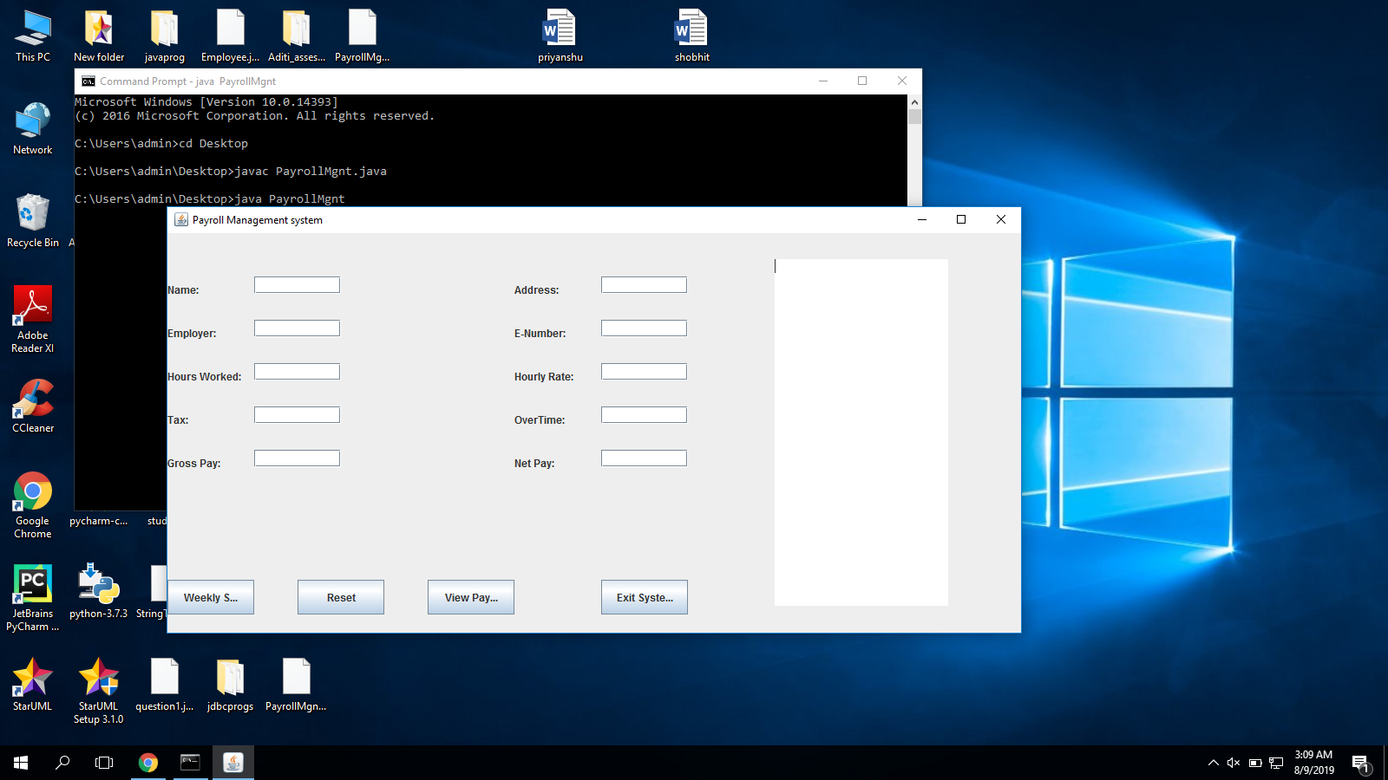
App window of Payroll management system opens up.

Slide 4
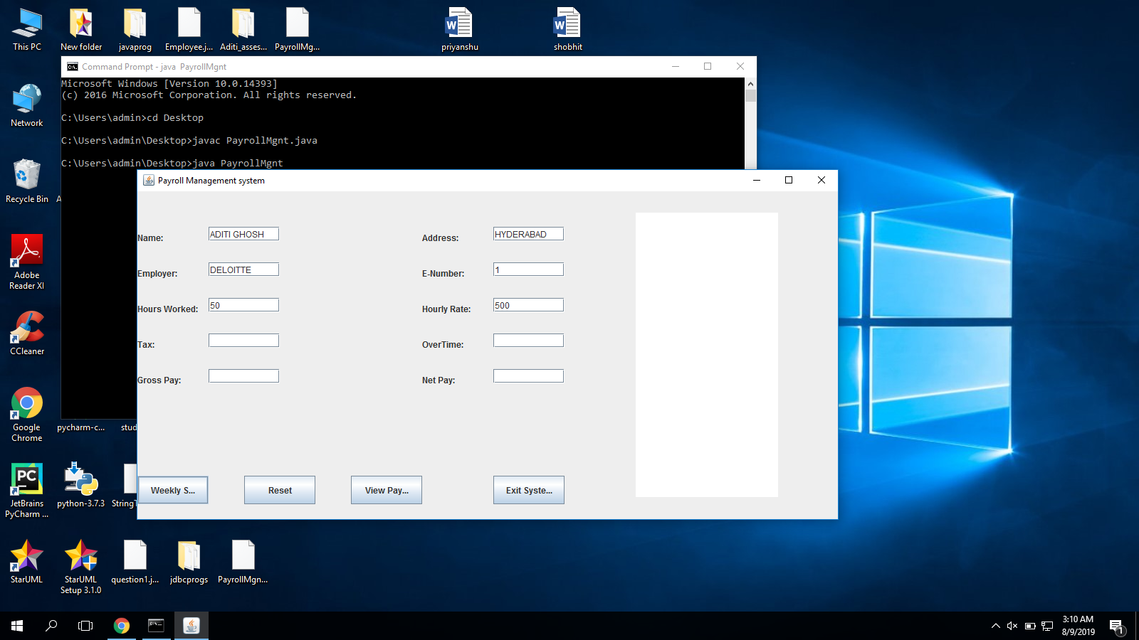
Adding details (Name,Address,Employer,E-number,Hours worked and Hourly Rate)

Slide 5

Click on weekly salary button to get values of Tax,Overtime,Gross Pay & Net Pay

Slide 6
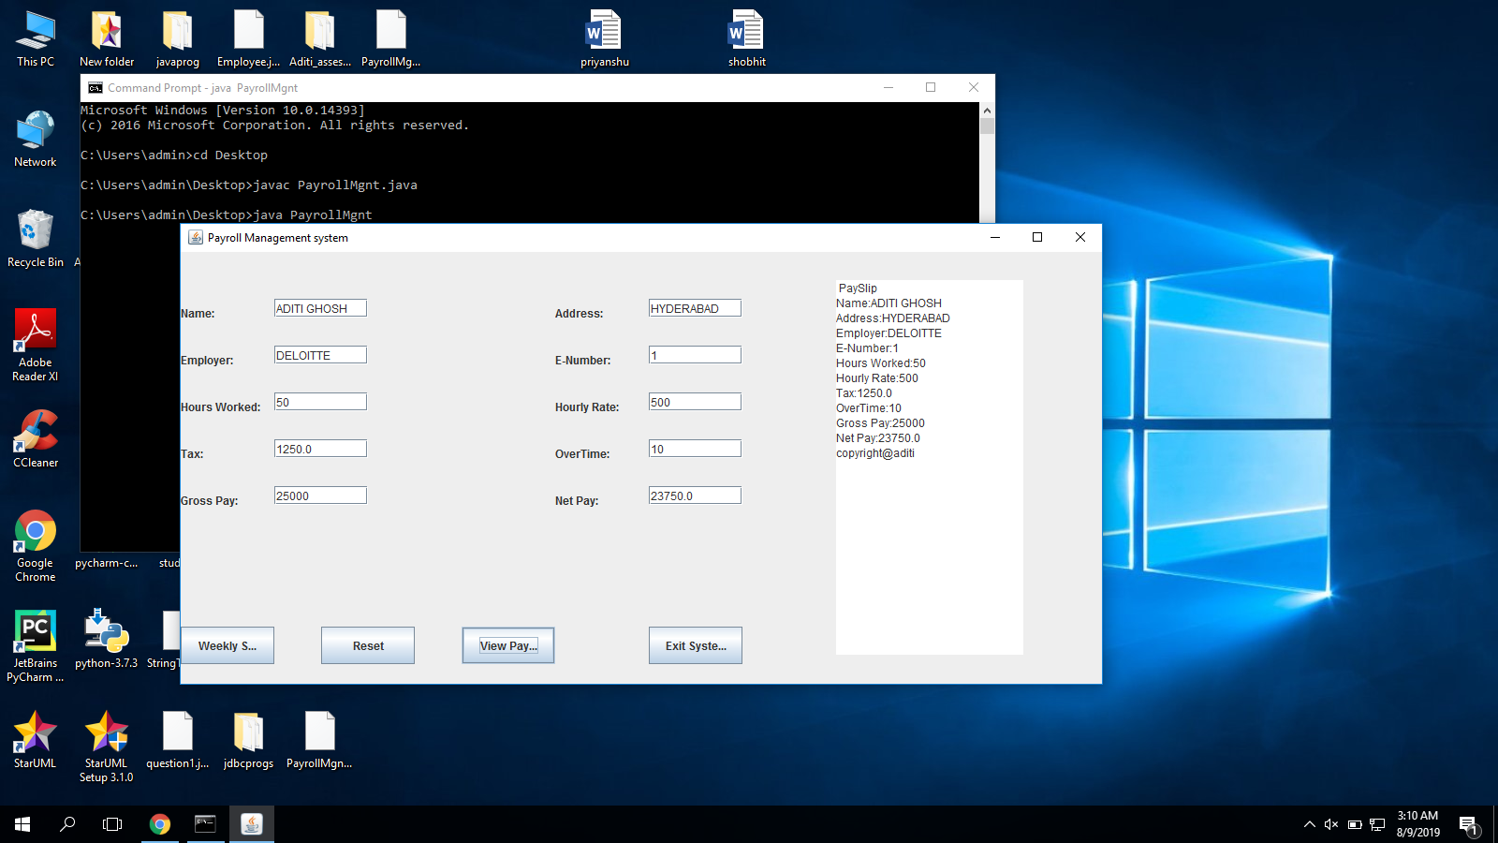
Click on View Payslip Button to see the Payslip in textarea

Slide 7

Click on reset button to reset the fields

Slide 8
Click on Exit Button to exit the window

